Slide 1

INNOMATICS
RESEARCH LABS
PROJECT ON
WEB SCRAPING AND EXPLORATORY DATA ANALYSIS ON SECOND-HAND (DROOM) BIKE LISTINGS
Presented By:
SHAIK SHAREEF

Slide 2
PROBLEM STATEMENT
The used bike market in India lacks clear and fair pricing.
Buyers and sellers cannot easily compare bikes by brand, year, or mileage.
This project uses web scraping from Droom to collect real data.
EDA helps find trends and insights for better price understanding.
To collect real-time used bike data from the Droom website using web scraping.
To clean and organize the collected data for analysis.
To analyze key factors like brand, price, year, and mileage using EDA.
To find trends and patterns in the used bike market.
To help buyers and sellers make better pricing decisions based on data insights.
OBJECTIVE

Slide 3
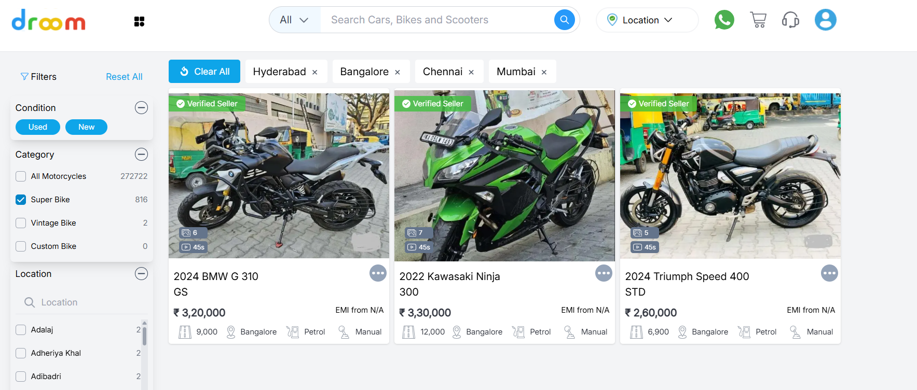
The website used for Web Scraping and obtained the data from – Website Link

Slide 4
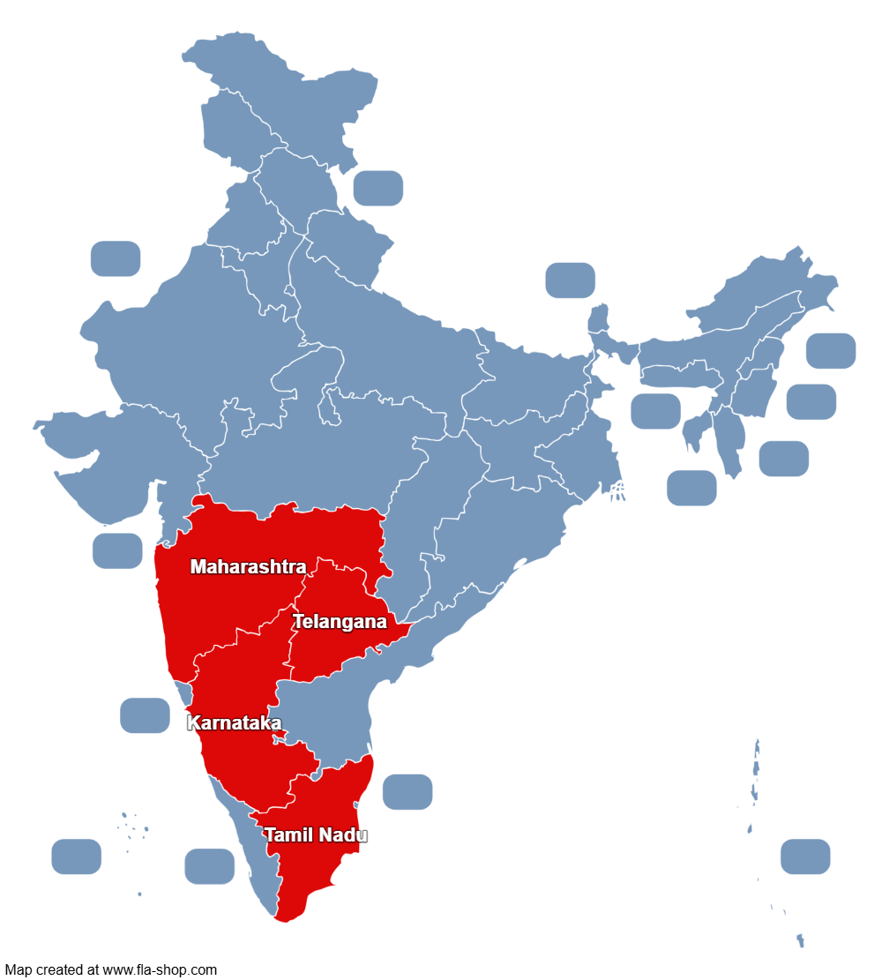
I have extracted details of used bikes from four major cities
Like :
1.Hyderabad
2.Bangalore
3.Chennai
4.Mumbai

Slide 5
FEATURES EXTRACTED
Columns
Brand
Model
Price
Location
Engine
Model Year
Fuel Type
Road Trip

Slide 6
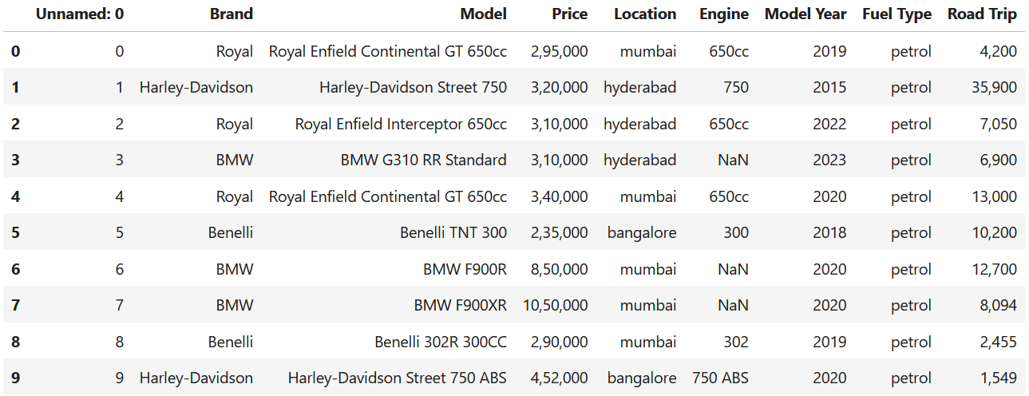
After scraping our final dataset

Slide 7
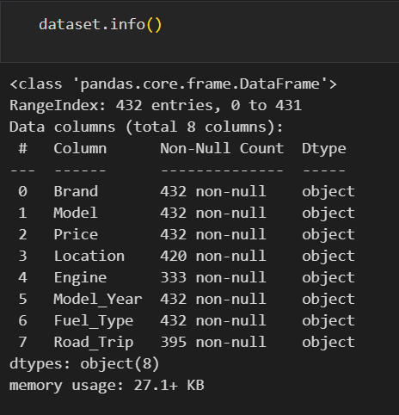
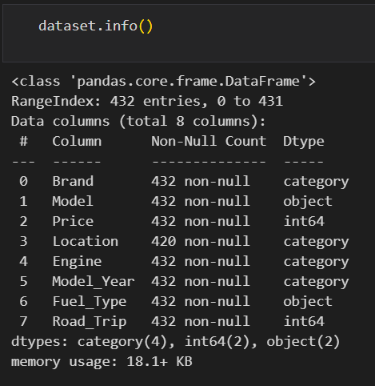
Memory reduction

Slide 8
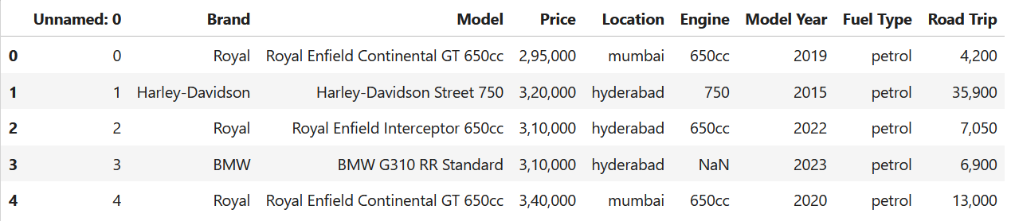
Data cleaning
The cleaning process remove the unwanted columns and data

Slide 9
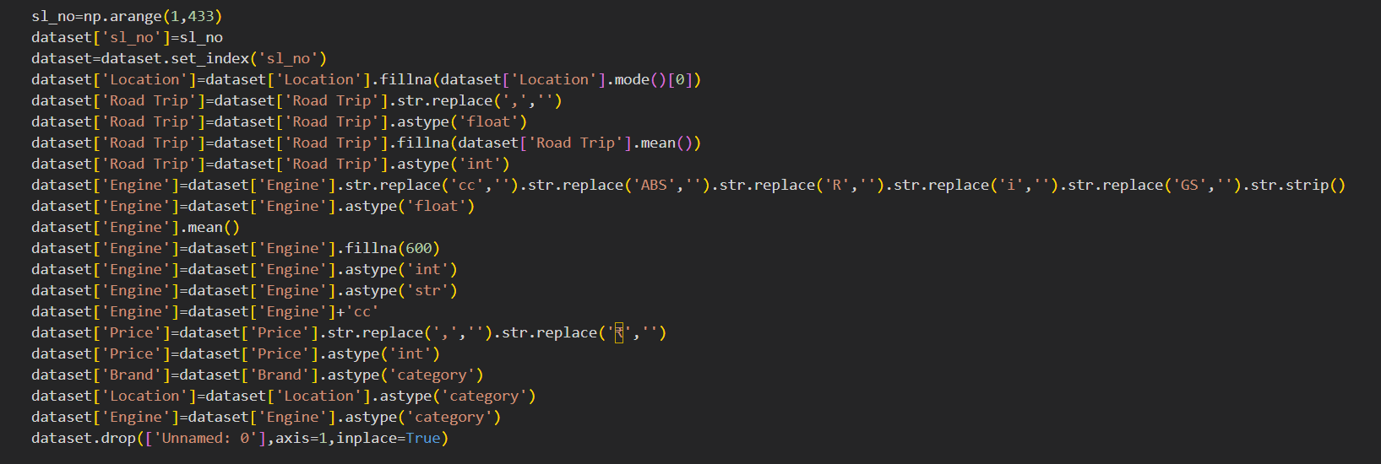
Code For Data Cleaning

Slide 10
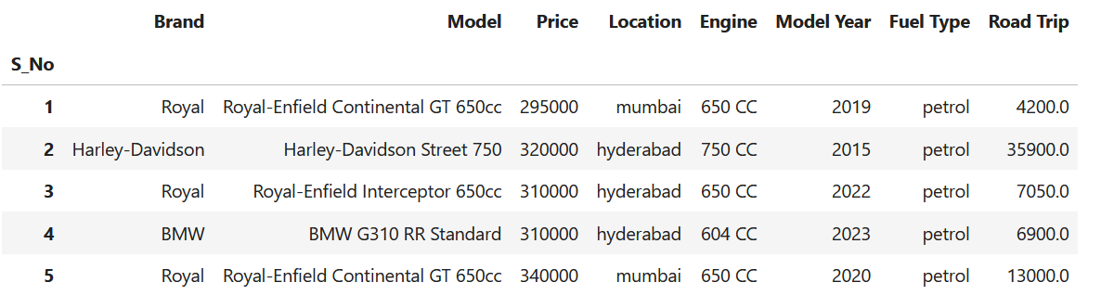
Final Dataset after performing data cleaning operations

Slide 11
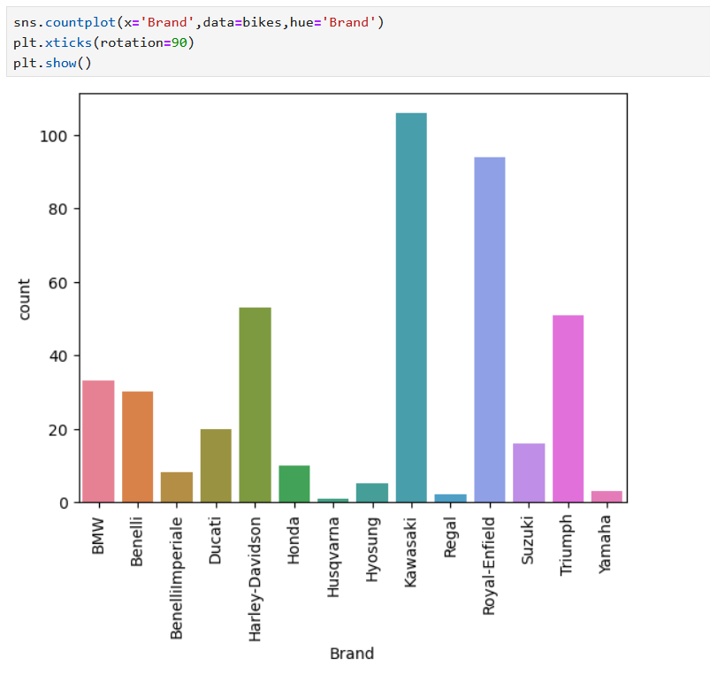
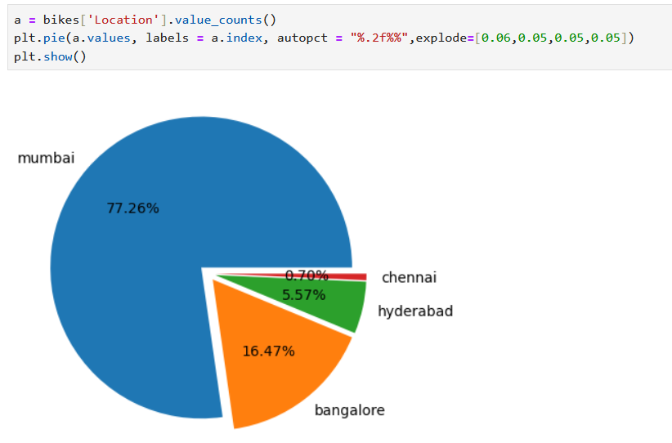
Univariate Analysis

Slide 12
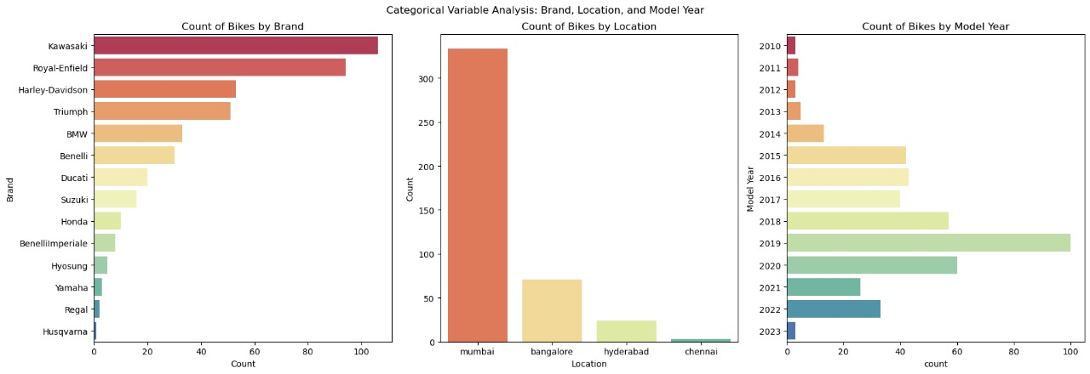
Kawasaki has the highest number of bikes listed.
Mumbai has the most bike listings — it is the main market.
Hyderabad has a few, while Chennai has the least.
Most bikes are from 2018, 2019, and 2020.
This means most bikes are recent and well-maintained.

Slide 13
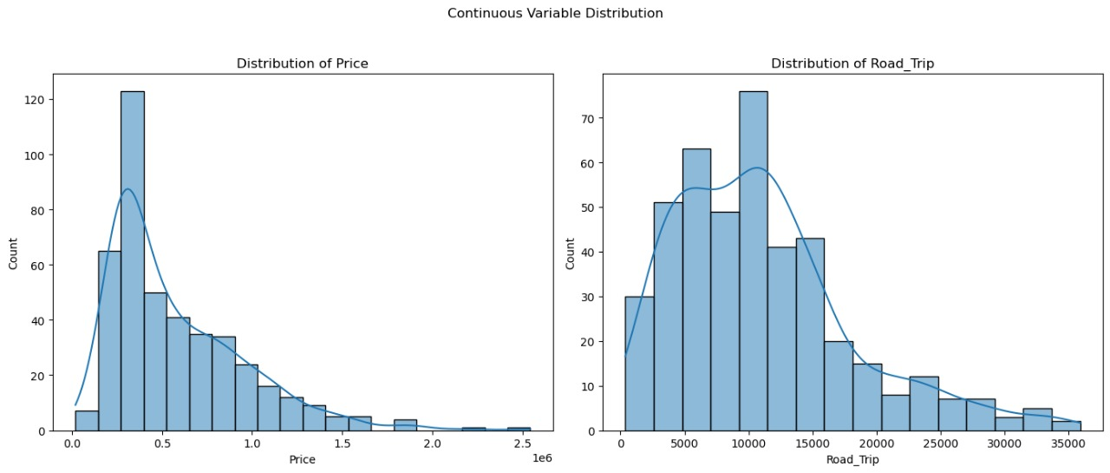

Slide 14
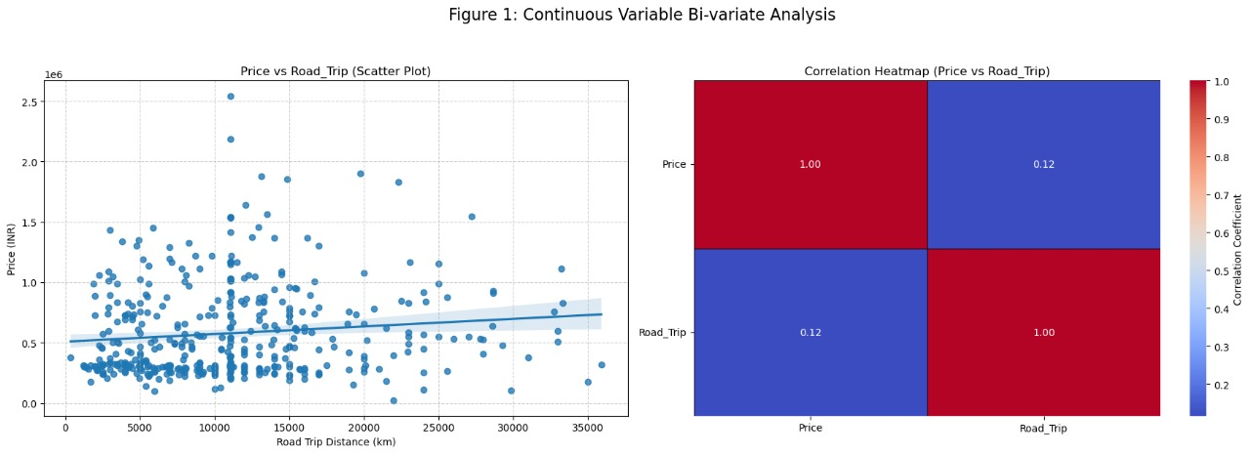
Bivariate Analysis
The upward trend line shows a slight positive relationship between Price and Road Trip distance.
However, the points are widely spread, meaning the relationship is weak — higher road trip distance
does not strongly affect the price.
This value is close to zero, which means there is very little or
no linear relationship between how far a bike has traveled and its price.

Slide 15
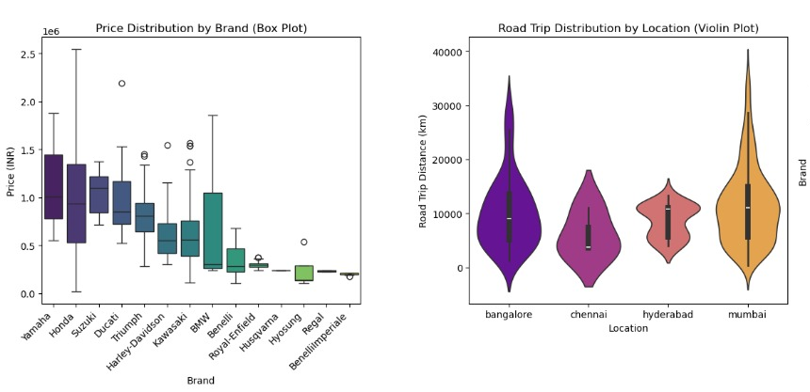

Slide 16
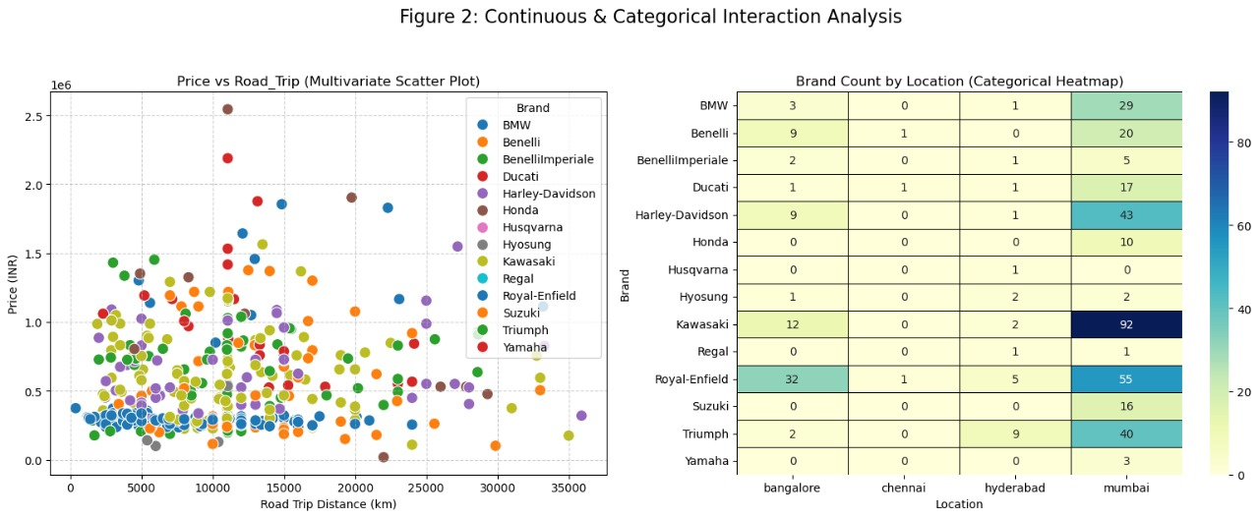

Slide 17
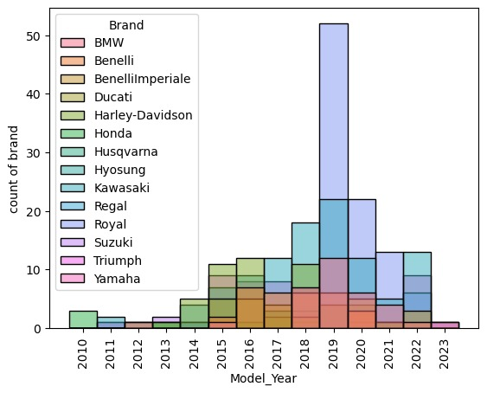
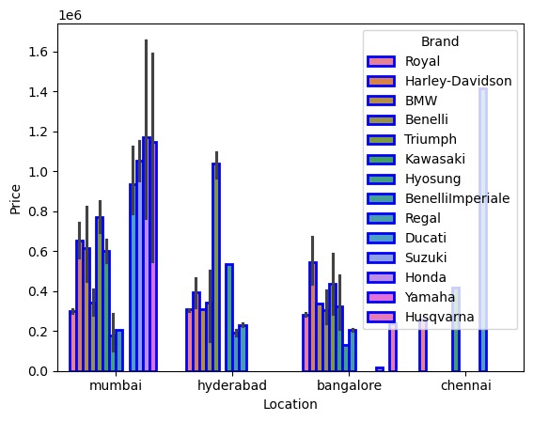

Slide 18
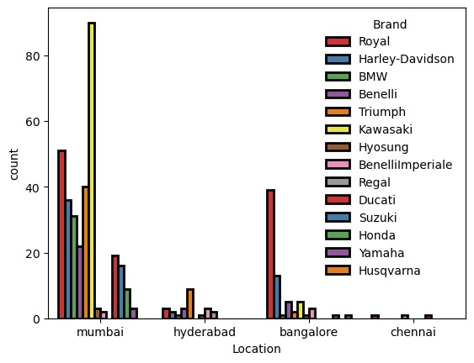
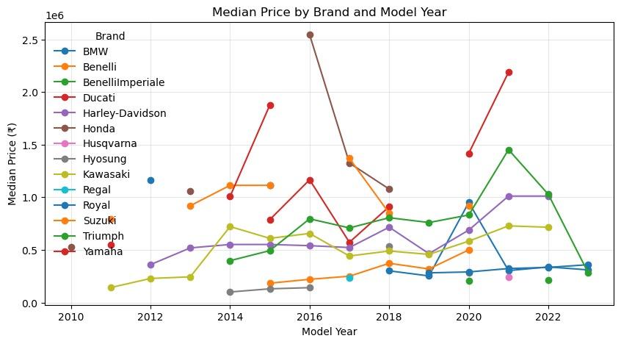

Slide 19
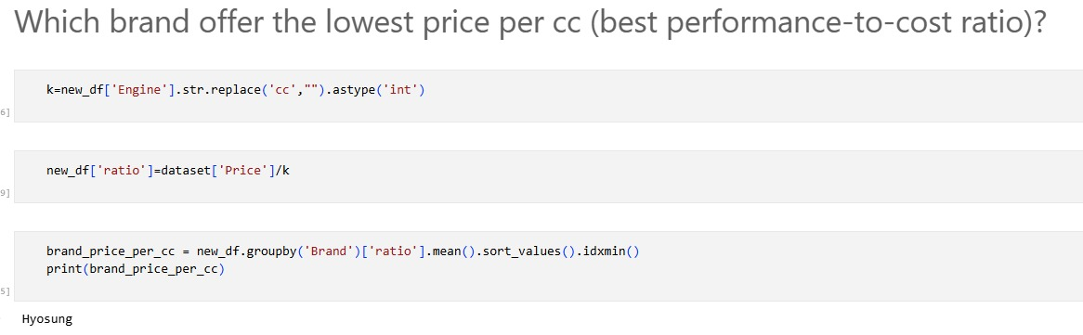

Slide 20
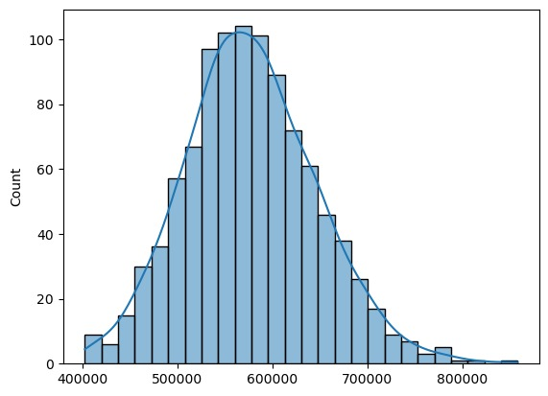
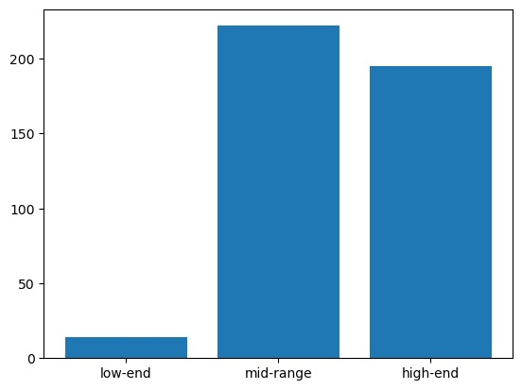

Slide 21


